Slide 1


Lakshmanan
16-OCT-2024

Slide 2
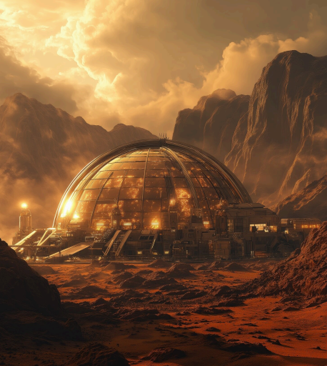

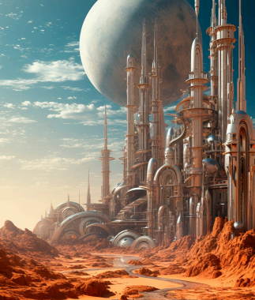
Introduction to Martian vision for a Martian colony is not just a dream; it’s a bold mission. This presentation explores the innovative concepts and technological advancements that could make life on Mars a reality
Why Mars?
Mars presents a unique opportunity for human expansion. Its resources, potential for colonization, and the quest for scientific discovery make it an ideal target for exploration beyond Earth.
Future Vision:
A Self-sustaining City Musk envisions a self-sustaining city on Mars, where humans can thrive. This city would rely on local resources for food, water, and energy, creating a closed-loop ecosystem.

Slide 3
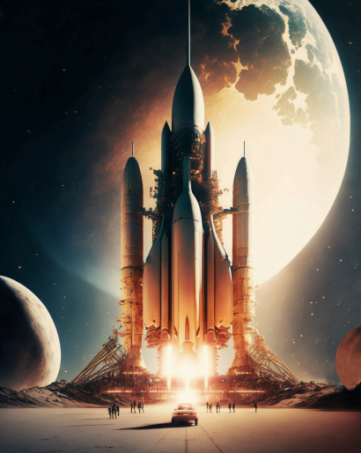
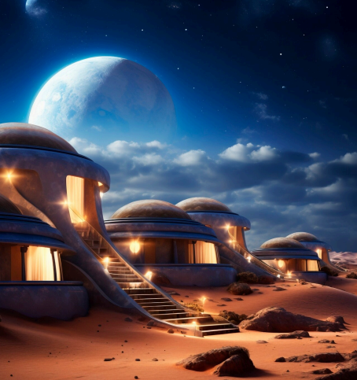
Transportation to Mars:
The Starship rocket is key to Musk's plans. Designed for reusability, it aims to transport humans and cargo to Mars efficiently, reducing costs and making regular trips feasible
Building a Martian Habitat:
Creating a habitat on Mars involves innovative architecture and technology. Structures must withstand harsh conditions while providing a comfortable living environment for inhabitants

Slide 4
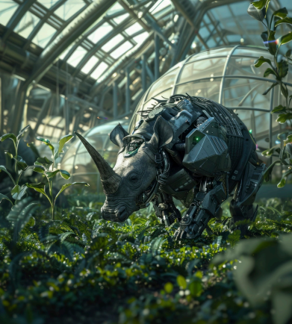
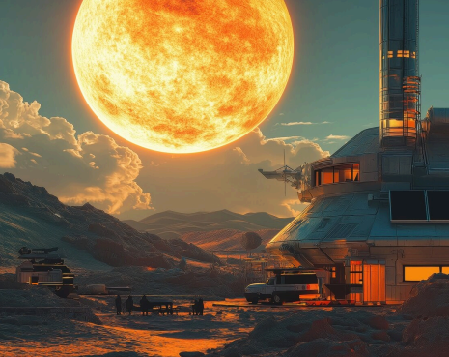
Life Support Systems:
Essential to survival, life support systems will manage air, water, and food. Technologies like hydroponics and recycling will be vital for sustaining human life on Mars
Energy Solutions:
Mars presents unique challenges for energy generation. Solar panels and nuclear power are potential solutions to provide the necessary energy for a thriving colony
Terraforming Mars:
Musk has proposed terraforming Mars to make it more Earth-like. This involves altering the planet's atmosphere and temperature, a long-term goal that could take centuries.

Slide 5
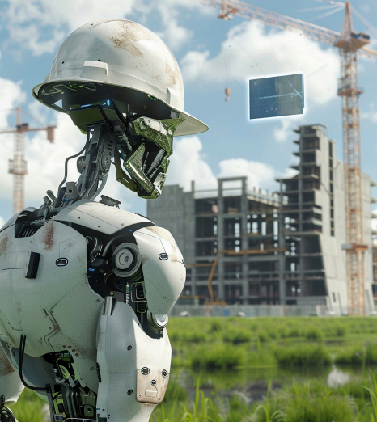

The Role of Technology:
Advanced robotics and AI will play a crucial role in establishing a Martian colony. These technologies will assist in construction, maintenance, and daily operations, ensuring efficiency.
Challenges Ahead:
Despite the potential, many challenges exist, including radiation exposure, psychological effects of isolation, and resource scarcity. Addressing these issues is vital for a successful colony.
Community and Culture:
A Martian colony would not just be about survival; it’s about building a community. Cultural activities, education, and social interactions will be essential for a thriving society
Conclusion: The Future Awaits:
Elon Musk's vision for a Martian colony represents a new frontier for humanity. With determination and innovation, we can turn this dream into a vibrant reality on Mars.

Slide 6


